Slide 1
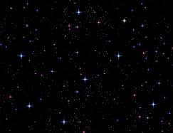
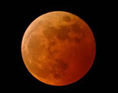
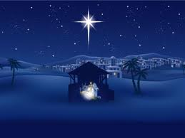
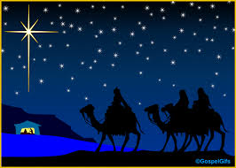
東方三博士
We Three Kings of Orient Are
S120

Slide 2
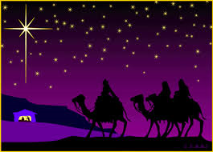
三位博士来自东方， 携带礼物献给君王， 经过田野、荒漠、山川， 日夜跟随星光。
We three kings of orient are, Bearing gifts we traverse afar Field and fountain, Moor and mountain, Following yonder star.

Slide 3
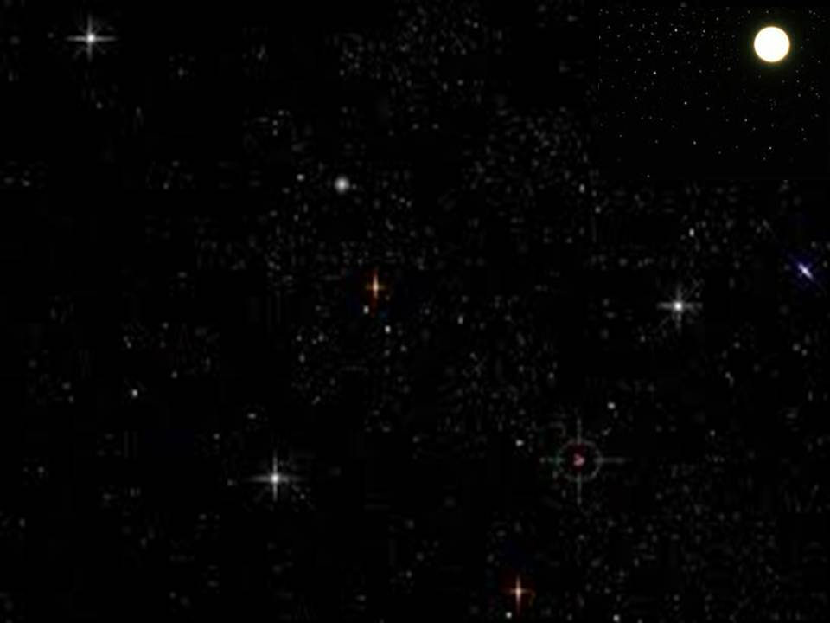
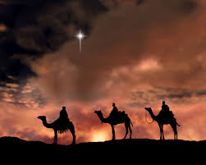
(副歌） 哦！奇妙明星放光芒， 灿烂无比真辉煌。
明星引领不断前进，直到朝见主真光。
O star of wonder, star of night, Star with royal beauty bright. Westward leading, still proceeding, Guide us to thy perfect light.

Slide 4
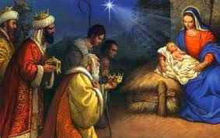
Born a King on Bethlehem's plain, Gold I bring to crown Him again King for ever, ceasing never Over us all to reign.
我献黄金尊贵至上， 做他冠冕贺他为王， 永永远远统治我们， 恩泽地久天长。

Slide 5
O star of wonder, star of night, Star with royal beauty bright. Westward leading, still proceeding, Guide us to thy perfect light.
(副歌） 哦！奇妙明星放光芒， 灿烂无比真辉煌。
明星引领不断前进，直到朝见主真光。

Slide 6
我献乳香芬芳四溢， 救主恩爱万民受益， 祈祷、感谢、赞美、颂扬， 当作馨香之祭。
Frankincense to offer have I, Incense owns a Deity nigh Prayer and praising, all men raising, Worship Him, God most high.

Slide 7
(副歌） 哦！奇妙明星放光芒， 灿烂无比真辉煌。
明星引领不断前进，直到朝见主真光。
O star of wonder, star of night, Star with royal beauty bright. Westward leading, still proceeding, Guide us to thy perfect light.

Slide 8
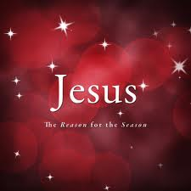
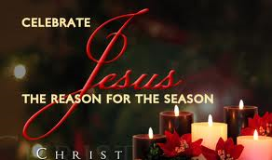
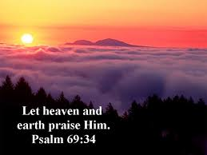
Glorious now behold Him arise, King and God and Sacrifice! Al-le-lu-ia, al-le-lu-ia, Sounds thru the earth and skies.
君王上主为人牺牲， 何等荣耀，他已得胜！
哈利路亚，哈利路亚！ 天上人间同唱。

Slide 9
O star of wonder, star of night, Star with royal beauty bright. Westward leading, still proceeding, Guide us to thy perfect light.
(副歌） 哦！奇妙明星放光芒， 灿烂无比真辉煌。
明星引领不断前进，直到朝见主真光。

